Slide 1
Analog and Digital Electronic Lab Subject Code:18csl37
To design and implement an astable multivibrator using 555 Timer for a given frequency and duty cycle.

Slide 2
Multivibrator
Multivibrator is a form of oscillator, which has a non-sinusoidal output. The output waveform is rectangular.
There are three basic types
Astable – has no stable states, but switches continuously between two states. This action produces a train of square wave pulses at a fixed frequency.
Monostable – one of the states is stable, but the other state is unstable (transient).
Bistable – the circuit is stable in either state.

Slide 3
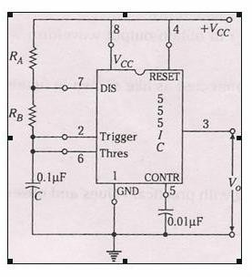
CIRCUIT DIAGRAM

Slide 4
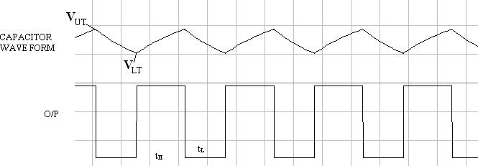
WAVEFORMS

Slide 5
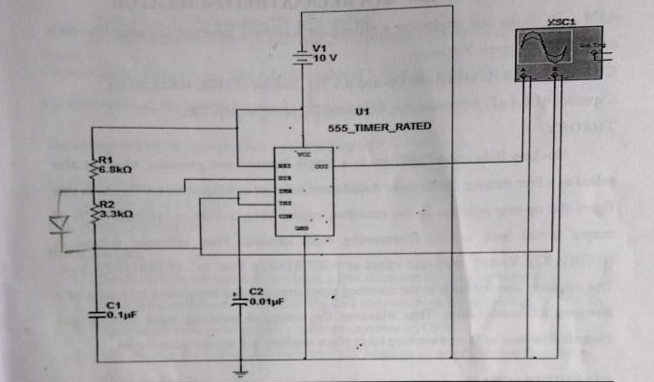
555 timer using Multisim

Slide 6
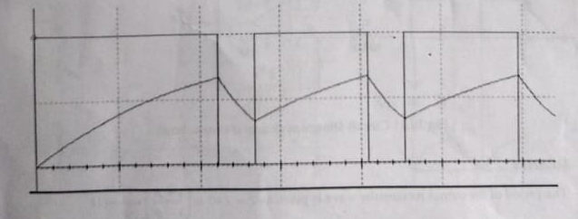
WAVEFORMS

Slide 7
Thank you

